Slide 1

Big Data Processes ‘24
W01 Exercise Session

Slide 2


Agenda
1) Introduction
2) Group formation
3) Installing Python and VS Code
BREAK
5) Mini-tutorial on Jupyter Notebook
4) Explore your first notebook!

Slide 3



1. Introduction
Who are we?
Our role
The structure of the exercise sessions
Lucie Mezníková (lume@itu.dk)
DIM 4th semester
Sofie Nielsen (soni@itu.dk)
Software Design
Emilie Groth (emig@itu.dk)
DIM 4th semester

Slide 4

2. Group formation
Preferably 5 members pr. group
When you form a group, register it on LearnIT in "Project Groups" (top of course page under "About this course")
If you are looking for a group, you can make a group in "Project Groups" and state in the group description that you are looking for group mates

Slide 5
3. Installing Python and VS Code
Find and go through the guide on LearnIT > W01 exercises
N.B.: There are guides for Mac and Windows, respectively
We’ve decided to use VS Code in the course, but you can also open and edit notebooks using Anaconda and a browser (see guide on LearnIT, if you are interested). We TAs only support VS Code.

Slide 6

BREAK

Slide 7

4. Mini-tutorial introducing Jupyter notebooks
How to make a new notebook file
How to make new cells
How to run cells

Slide 8

What is Jupyter Notebooks?
Jupyter Notebooks is the tool we will use to visualize and manipulate our datasets + to create models
In other words, we will be executing our Python code inside these notebooks
Notebooks are structured in cells
Cells can contain either code (=code cell) or text (=markdown cell)
Cells can be executed individually (we'll get back to this in a minute)

Slide 9
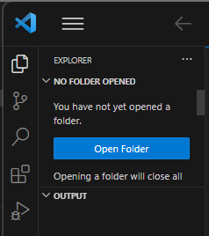
Making a Jupyter notebook file – step 1
Go into VSCode
Choose the folder you want your file to be saved in by pushing the button ”Open Folder”

Slide 10
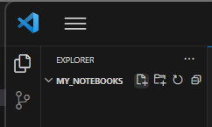
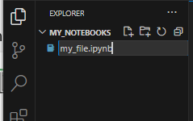
Making a Jupyter notebook file – step 2
Click on the small ”+”-file button
Name your file and add the ending ”.ipynb”

Slide 11
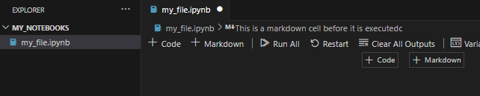
Making a cell
To make a new code/markdown cell, click here:

Slide 12
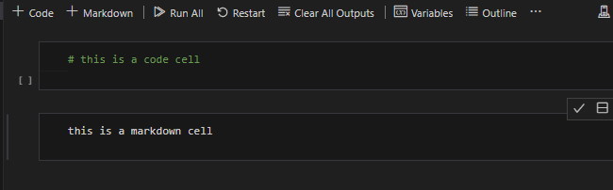
Markdown vs. code cells
Code cells are for Python code
Markdown cells are for notes and text
You can also insert notes in your code cells by using '#' in front of the text. This signals to Python that everything after the '#' is a comment and thus, should not be executed when running the cell

Slide 13
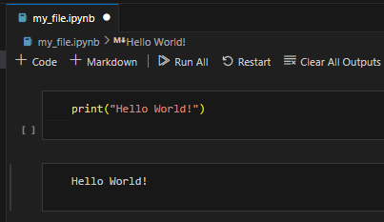
Mini-exercise
Make a code cell with the python code: print(”Hello World!”)
Make a markup cell with the text: Hello World!
It should look like this:

Slide 14
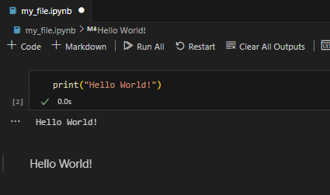
Running a cell
Ctrl+Enter (Windows) or Cmd+Enter (Mac) will run the cell
Running a code cell = executing the code
Running a markdown cell = prints the text in the cell
Try running your two cells, they should now look like this:
BEFORE
AFTER

Slide 15

Edit mode vs. command mode
Cells can be in one of two modes
In edit mode, you can write stuff in the cell
In command mode, you can use a range of notebook short-cuts (which you will see shortly)

Slide 16


Edit mode
When cells are in edit mode the cell will have a blue frame
To enter edit mode mark the cell by clicking on it and hit enter OR double click in the text area of the cell
Markdown cell in edit mode
Code cell in edit mode

Slide 17

Command mode
When cells are in command mode the cell will NOT have a blue frame
To enter command mode in a cell, mark the cell by clicking on the left side so it turns blue
Markdown cell in command mode
Code cell in command mode

Slide 18
Recap: command mode vs. edit mode
Markdown cell in command mode
Code cell in command mode
Markdown cell in edit mode
Code cell in edit mode

Slide 19
Command mode shortcuts
These shortcuts only work in command mode (i.e., when the curser is not visible and the cell is not framed in blue)
Short cut | What happens?
m | Changes code cell to markup cell
y | Changes markup cell to code cell
dd | Deletes the cell
a | Inserts cell above
b | Inserts cell below
Ctrl+Enter / Cmd+Enter | Run cell and stay at the cell
Shift+Enter | Run cell and move to next cell
Enter | Go to edit mode in the given cell
Use google to find more short cuts if you like!

Slide 20
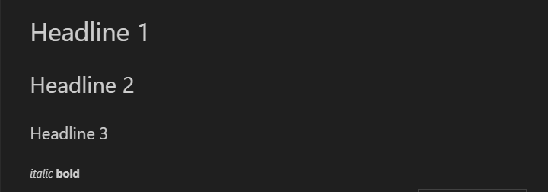
Extra mini-exercise: formatting in markup cells
N.B. This exercise will likely require you to google/ask ChatGPT for help
Make a new file with four markup cells that looks like this when the cells have been run

Slide 21
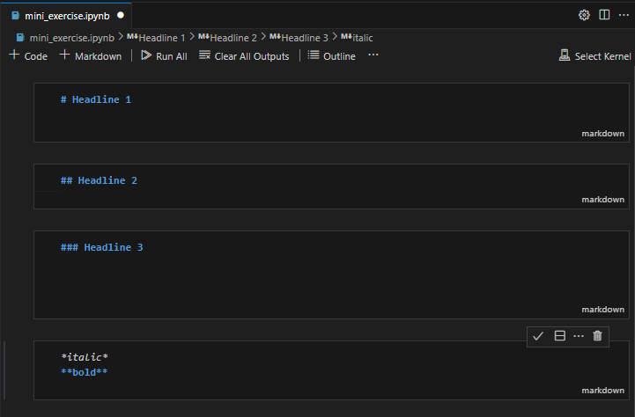

Solution to the mini-exercise

Slide 22
5) Explore your first notebook
We’ve uploaded a notebook showcasing essential operations, such as loading and examining a dataset
Find it on LearnIT in the W01 exercise folder (N.B.: download the whole folder, i.e., both the .ipynb-file and the .txt-file)
Read and run the notebook and solve the exercises
When you are done, the solution can be found on LearnIT

